Slide 1
Artificial Neural Networks Tutorial 11
KDM-Spring-2020

Slide 2
Goal
1) Building the Following Feed forward Networks:
Auto Encoders
Convolutional neural network, CNN
2) Getting use to with Google Colab

Slide 3

Google Colab
Google Colab is a free cloud service and now it supports free GPU!
With Google Colab You can:
improve your Python programming language coding skills.
develop deep learning applications using popular libraries such as Keras, TensorFlow, PyTorch, and OpenCV.
The most important feature that distinguishes Colab from other free cloud services is; Colab provides GPU and is totally free.

Slide 4

Data Set
The MNIST database of handwritten digits
Training set of 60,000 examples, and a test set of 10,000 examples

Slide 5
Autoencoders
Data compression is a big topic that’s used in computer vision, computer networks, computer architecture, and many other fields.
The point of data compression is to convert our input into a smaller representation that we recreate, to a degree of quality.
This smaller representation is what would be passed around, and, when anyone needed the original, they would reconstruct it from the smaller representation.
Autoencoders are unsupervised neural networks that use machine learning to do this compression

Slide 6
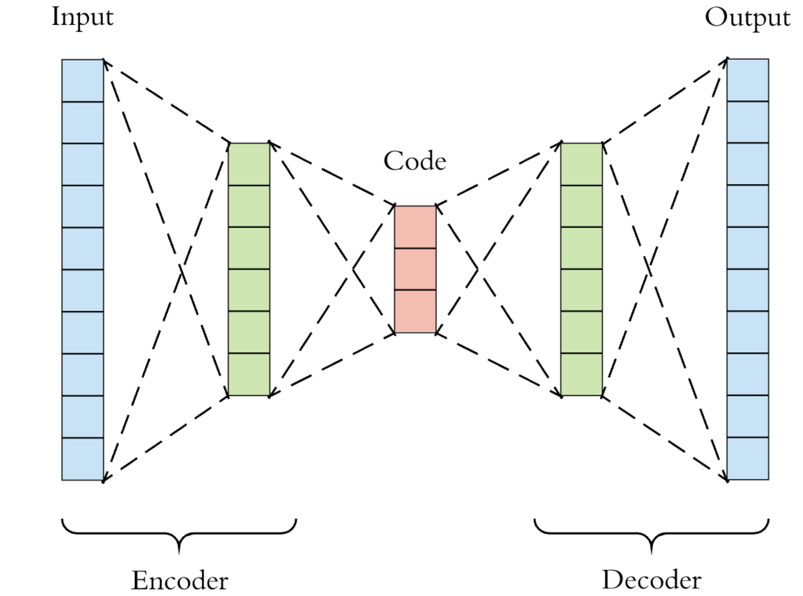
Autoencoders

Slide 7
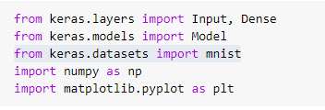
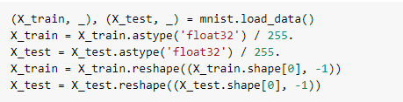
Autoencoder Code
Load MNIST handwritten digits dataset.
There is no need to load labels because autoencoders are unsupervised.
Rescale our images from 0 – 255 to 0 – 1 and flatten them out

Slide 8
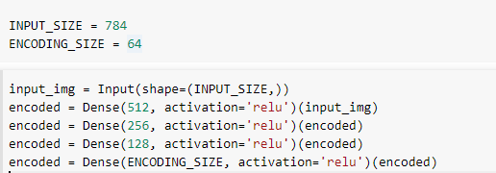
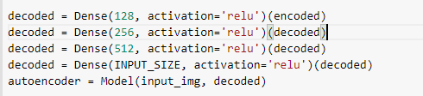
Autoencoders code
Create autoencoder
Use ReLU activation functions
create constants for our input size and our encoding size.
reduce our input from 784 -> 512 -> 256 -> 128 -> 64, encoder path
then expand it back up 64 -> 128 -> 256 -> 512 -> 784, decoder path

Slide 9
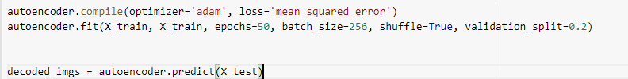
Autoencoder train and predict
Training the model and then making the prediction
Build and train the model.
Use the ADAM optimizer and mean squared error loss (the Euclidean distance/loss) between the input and reconstruction
encode and decode the test set to see how well model is performing

Slide 10
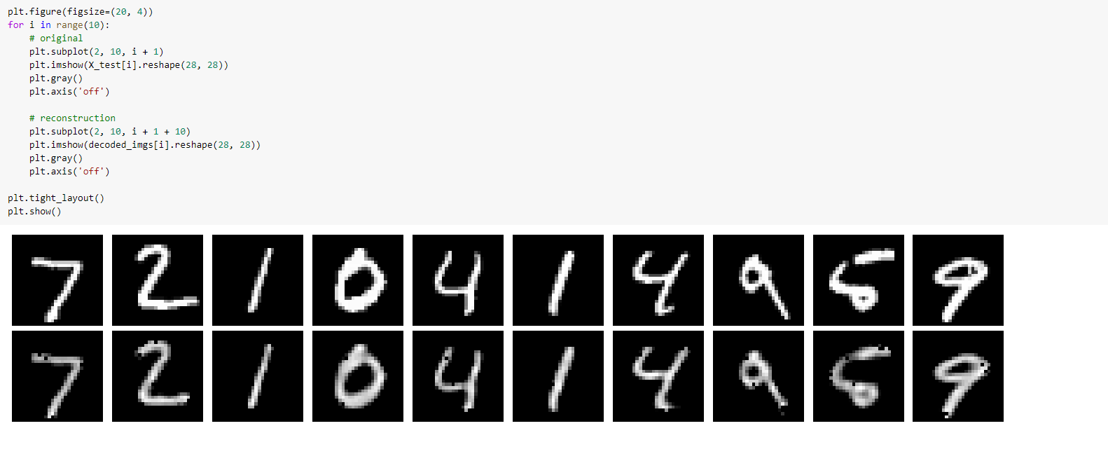
Autoencoders Result Visualization

Slide 11
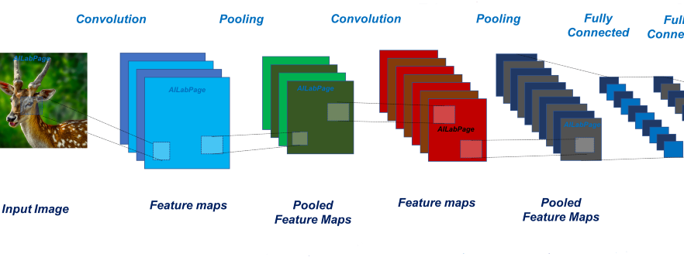
CNN

Slide 12
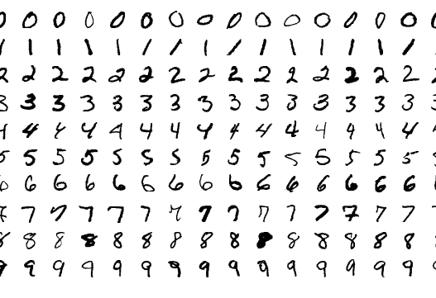
Problem Statement
The Problem: MNIST digit classification
We’re going to tackle a classic introductory Computer Vision problem: MNIST handwritten digit classification. It’s simple: given an image, classify it as a digit
Each image in the MNIST dataset is 28x28 and contains a centered, grayscale digit. Our CNN will take an image and output one of 10 possible classes (one for each digit)

Slide 13
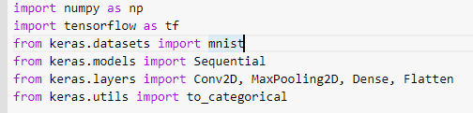
Code
Library imports
First of all, import all necessary packages

Slide 14
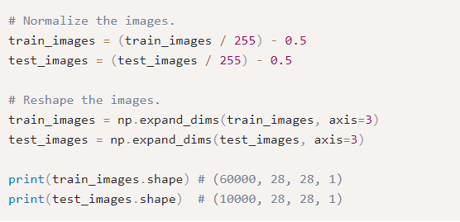
Data preparation
Before we begin, we’ll normalize the image pixel values from [0, 255] to [-0.5, 0.5]
This will make our network easier to train (using smaller, centered values usually leads to better results).
We’ll also reshape each image from (28, 28) to (28, 28, 1) because Keras requires the third dimension. (1 stands for color scheme, which is grey scale in this case).

Slide 15
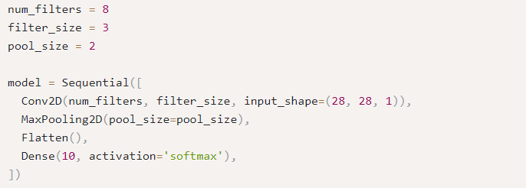
Model building
Keras model is either built using the Sequential class, which represents a linear stack of layers, or the functional Model class, which is more customizable.
We’ll be using the simpler Sequential model, since our CNN will be a linear stack of layers.

Slide 16
Model building
num_filters, filter_size, and pool_size are self-explanatory variables that set the hyperparameters for our CNN.
The first layer in any Sequential model must specify the input_shape, so we do so on Conv2D.
Once this input shape is specified, Keras will automatically infer the shapes of inputs for later layers.
The output Softmax layer has 10 nodes, one for each class

Slide 17
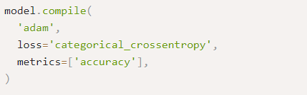
Model compilation
Before we can begin training, we need to configure the training process. We decide 3 key factors during the compilation step:
The optimizer. We’ll stick with a pretty good default: the Adam gradient-based optimizer. Keras has many other optimizers you can look into as well.
The loss function. Since we’re using a Softmax output layer, we’ll use the Cross-Entropy loss. Keras distinguishes between binary_crossentropy (2 classes) and categorical_crossentropy (>2 classes), so we’ll use the latter.
A list of metrics. Since this is a classification problem, we’ll just have Keras report on the accuracy metric.

Slide 18
Model Training
Training a model in Keras literally consists only of calling fit() and specifying some parameters. There are a lot of possible parameters, but we’ll only supply these:
The training data (images and labels), commonly known as X and Y, respectively.
The number of epochs (iterations over the entire dataset) to train for.
The validation data (or test data), which is used during training to periodically measure the network’s performance against data it hasn’t seen before.

Slide 19
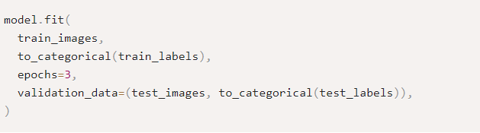
Model Training
There’s one thing we have to be careful about:
Keras expects the training targets to be 10-dimensional vectors, since there are 10 nodes in our Softmax output layer. Right now, our train_labels and test_labels arrays contain single integers representing the class for each image
Conveniently, Keras has a utility method that fixes this exact issue:
to_categorical: It turns our array of class integers into an array of one-hot vectors instead. For example, 2 would become [0, 0, 1, 0, 0, 0, 0, 0, 0, 0] (it’s zero-indexed)

Slide 20
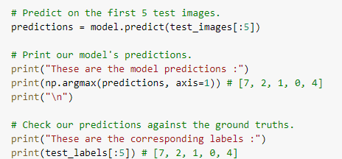
Predicting
We pass an array of inputs to predict() and it returns an array of outputs.
The output of our network is 10 probabilities (because of softmax), so we’ll use np.argmax() to turn those into actual digits.

Slide 21
References
https://victorzhou.com/blog/keras-cnn-tutorial/
https://pythonmachinelearning.pro/all-about-autoencoders/

